Slide 1
Compiler Design
Introduction to Compiler
Saeed Parsa
Room 332,
School of Computer Engineering,
Iran University of Science & Technology
parsa@iust.ac.ir
Winter 2021

Slide 2
Why compilers?
Compiler
Software Quality Measurement
Reverse Engineering
Software Security
Automatic Distribution & Parallelization
Software Testing

Slide 3
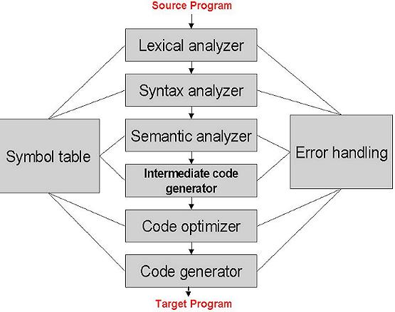
A compiler structure
Page 7 of the Aho’s Book

Slide 4
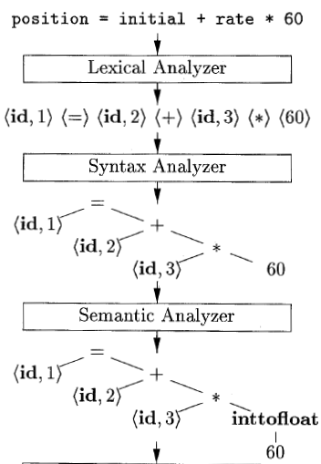
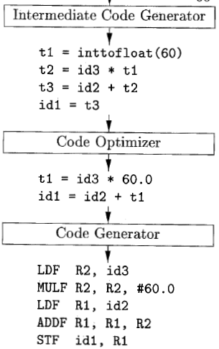
Compilation steps with an example
Page 7 of the Aho’s Book

Slide 5
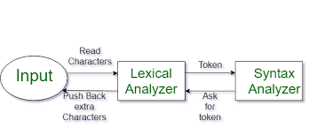
Example of compilation process
Consider the example statement:
position = initial + rate * 60
1. Lexical Analysis
There are 30 characters in the statement.
The characters are transformed by lexical analysis into a sequence of 7 tokens.
Token1.name = “position”;
Token2.name = “=“;
Token3.name = “initial“;
Token4.name = “+“;
Token5.name = “rate“;
Token6.name = “*“;
Token7.name = “60“;

Slide 6
Example of compilation process (Continued)
Consider the example statement:
position = initial + rate * 60
2. Syntax Analysis
Those tokens are then used by syntax analyzer to build a tree of height 4, representing the correctness of the statement according to the grammar.
G1:
assignmentSt ::= identifier = expression
expression ::= expression + term | expression – term | term
term ::= term * factor | term / factor | factor
factor ::= identifier | number | (expression)

Slide 7
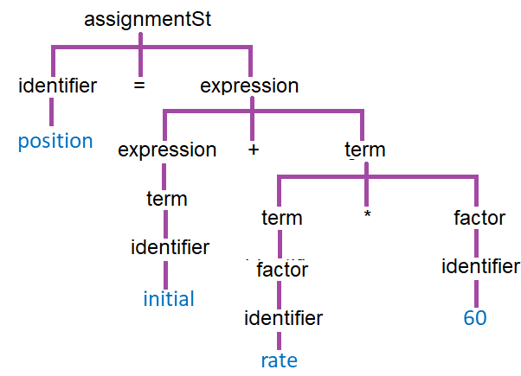
Example of compilation process (Continued)
Consider the example statement:
position = initial + rate * 60
2. Syntax Analysis
Those tokens are then used syntax analyzer to build a tree of height 4, representing the correctness of the statement according to the grammar.

Slide 8
Example of compilation process (Continued)
Consider the example statement:
position = initial + rate * 60
3. Semantics Analysis
Semantic analysis may transform the tree into one of height 5, that includes a type conversion necessary for real addition on an integer operand.
4. Intermediate code generation
Intermediate code generation uses a simple traversal algorithm to linearize the tree back into a sequence of machine-independent three-address-code instructions.
t1 = inttoreal(60)
t2 = id3 * t1
t3 = id2 + t2
id1 = t3
position = initial + rate * 60

Slide 9
Example of compilation process (Continued)
Consider the example statement:
position = initial + rate * 60
5. Optimization
Optimization of the intermediate code allows the four instructions to be reduced to two machine-independent instructions.
position = initial + rate * 60
t1 = inttoreal(60)
t2 = id3 * t1
t3 = id2 + t2
id1 = t3
t1 = id3 * 60.0
id1 = id2 + t1
http://www.personal.kent.edu/~rmuhamma/Compilers/compnotes.html

Slide 10
Example of compilation process (Continued)
Consider the example statement:
position = initial + rate * 60
7. Final code generation
Final code generation might implement these two instructions using 5 machine instructions, in which the actual registers and addressing modes of the CPU are utilized.
position = initial + rate * 60
MOVF id3, R2
MULF #60.0, R2
MOVF id2, R1
ADDF R2, R1
MOVF R1, id1
t1 = inttoreal(60)
t2 = id3 * t1
t3 = id2 + t2
id1 = t3
t1 = id3 * 60.0
id1 = id2 + t1
http://www.personal.kent.edu/~rmuhamma/Compilers/compnotes.html

Slide 11
Compiler construction tools
On-line documentation is available for the following compiler tools:
Scanner generators for C/C++: Flex (pdf), Lex (pdf).
Parser generators for C/C++: Bison (in HTML), Bison (pdf), Yacc (pdf).
Available scanner generators for Java:
JLex, a scanner generator for Java, very similar to Lex.
JFLex, flex for Java.
http://www.personal.kent.edu/~rmuhamma/Compilers/compnotes.html

Slide 12
Compiler construction tools
Available parser generators for Java:
CUP, a parser generator for Java, very similar to YACC.
BYACC/J, a different version of Berkeley YACC for Java. It is an extension of the standard YACC (a -j flag has been added to generate Java code).
Other compiler tools:
JavaCC, a parser generator for Java, including scanner generator and parser generator. Input specifications are different than those suitable for Lex/YACC. Also, unlike YACC, JavaCC generates a top-down parser.
ANTLR, a set of language translation tools (formerly PCCTS). Includes scanner/parser generators for C, C++, and Java.

Slide 13
Compiler construction tools
1. Parser Generators
2. Scanner Generators
3. Syntax-directed Translation Engines
4. Automatic Code Generators
5. Data-flow Analysis Engines
6. Compiler Construction Toolkits

Slide 14
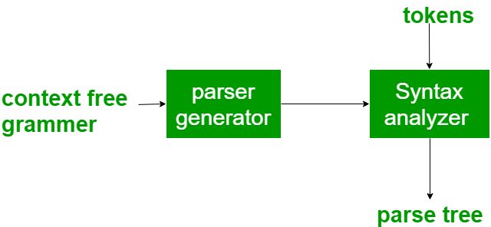
1. Parser Generators
It produces syntax analyzers (parsers) from the input that is based on a grammatical description of programming language or on a context-free grammar.
It is useful as the syntax analysis phase is highly complex and consumes more manual and compilation time.
Example: PIC, EQM, ANTLR, YACC

Slide 15
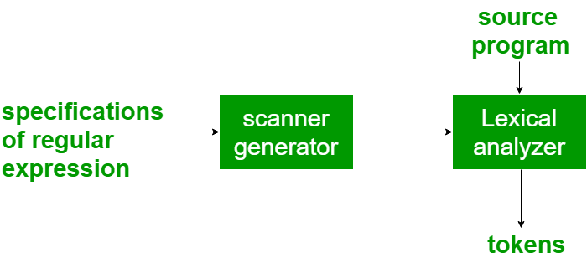
2. Scanner Generators
It generates lexical analyzers from the input that consists of regular expression description based on tokens of a language.
It generates a finite automaton to recognize the regular expression.
Example: Lex, Flex, ANTLR

Slide 16
Compiler construction tools
Syntax-directed translation engines that produce collections of routines for walking a parse tree and generating intermediate code.
Code-generator generators that produce a code generator from a collection of rules for translating each operation of the intermediate language into the machine language for a target machine.
Data-flow analysis engines that facilitate the gathering of information about how values are transmitted from one part of a program to each other part. Data-flow analysis is a key part of code optimization.
Compiler-construction toolkits that provide an integrated set of routines for constructing various phases of a compiler.
Page 8 of the Aho’s Book

Slide 17
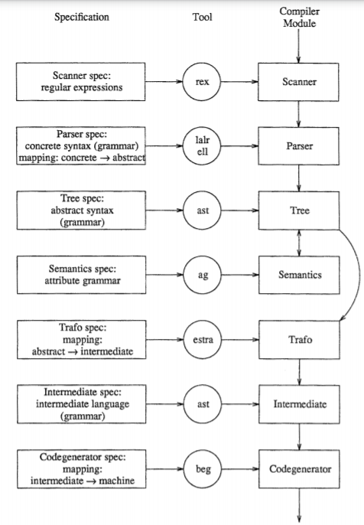
Compiler construction tools
https://link.springer.com/content/pdf/10.1007%2F3-540-53669-8_77.pdf

Slide 18
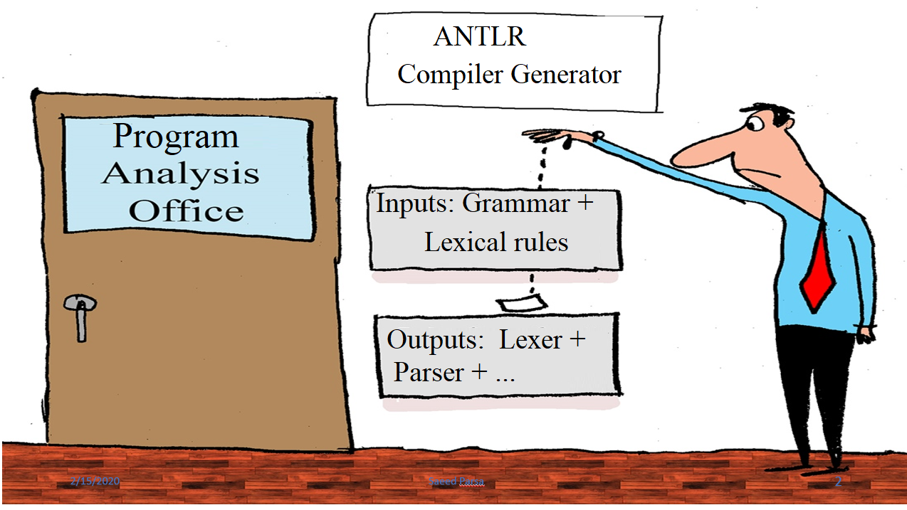
What is ANTLR?

Slide 19

What is ANTLR?
ANTLR, Another Tool for Language Recognition, (formerly PCCTS) is a language tool that provides a framework for constructing recognizers, compilers, and translators from grammatical descriptions.
ANTLR is a parser generator.
ANTLR is open source, written in JAVA.
ANTLR provides a “tree walker” to traverse parse tress.
There are two tree walking mechanism provided by the ANTLR library - Listener & Visitor.

Slide 20
What is ANTLR?
There are 3 primary differences between the Listener and Visitor libraries:
Listener methods are called automatically by the ANTLR provided walker object, whereas visitor methods must walk their children with explicit visit calls. Forgetting to invoke visit() on a node’s children means those subtrees don’t get visited
Listener methods can’t return a value, whereas visitor methods can return any custom type. With listener, you will have to use mutable variables to store values, whereas with visitor there is no such need.
Listener uses an explicit stack allocated on the heap, whereas visitor uses call stack to manage tree traversals. This might lead to Stack Overflow exceptions while using visitor on deeply nested ASTs.

Slide 21

What is ANTLR?
Antlr is a public-domain, software tool developed by Terence Parr to assist with the development of translators and compilers.
ANTLR automatically generates the lexical analyzer and parser for you by analyzing the grammar you provide.
Lexer
ANRLR Parser Generator
Grammar
Parser

Slide 22
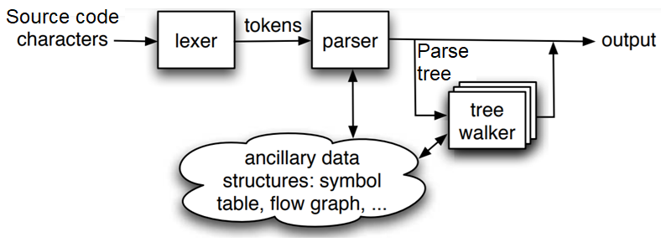
What is ANTLR?
A parse tree walker allows walking through the parse tree and perform any action at each node.

Slide 23
Why to use ANTLR?
ANTLR is extremely popular with 5,000 downloads a month and is included on all Linux and OS X distributions. It is widely used because it:
Generates human-readable code that is easy to fold into other applications
Generates powerful recursive-descent recognizers using LL(*), an extension to LL(k) that uses arbitrary look ahead to make decisions
Tightly integrates StringTemplate,5 a template engine specifically designed to generate structured text such as source code
Has a graphical grammar development environment called ANTLRWorks6 that can debug parsers generated in any ANTLR target language

Slide 24
Why to use ANTLR?
Is actively supported with a good project website and a high-traffic mailing list7
• Comes with complete source under the BSD license
Is extremely flexible and automates or formalizes many common tasks
Supports multiple target languages such as Java, C#, Python, Ruby, Objective-C, C, and C++.
See:
http://www.stringtemplate.org
http://www.antlr.org/works
http://www.antlr.org:8080/pipermail/antlr-interest/
https://doc.lagout.org/programmation/Pragmatic%20Programmers/The%20Definitive%20ANTLR%20Reference.pdf

Slide 25
Install ANTLR
ANTLR is written in Java, so you must have Java installed on your machine even if you are going to use ANTLR with, say, Python. ANTLR requires a Java version of 1.6 or higher.
Step 1: Install Java
1.1 Download and install Java JDK 13.0.2 (64-bit). Java Development Kit (64-bit).
Date released 2018. Free Download. (159.8 MB).
https://www.filehorse.com/download-java-development-kit-64/old-versions/page-2/
Step 2: Download the tool
2.1 Download antlr-4.8-complete.jar (or whatever version) from https:
https://www.antlr.org/download/
2.2 Save antlr-4.8-complete.jar to your directory for 3rd party Java libraries, say:
C:\Javalib

Slide 26
Install ANTLR
Step 3: Set paths
3.1 Create three text files antlr.txt, grun.txt and class.txt and save then to c:\java.lib
3.2 Rename the above files to antlr.bat, grun.bat and class.bat
3.3 Copy the following commands into the batch files:
class.bat: SET CLASSPATH=.; %CLASSPATH%
grun.bat: java org.antlr.v4.gui.TestRig %*
antlr.bat: java org.antlr.v4.Tool %*
3.4 Add antlr-4.8-complete.jar to CLASSPATH, either:
Permanently: Using Control Panel > System > Advanced system settings > Environment variables
3.5 Use the windows search, to look for “environment”.

Slide 27
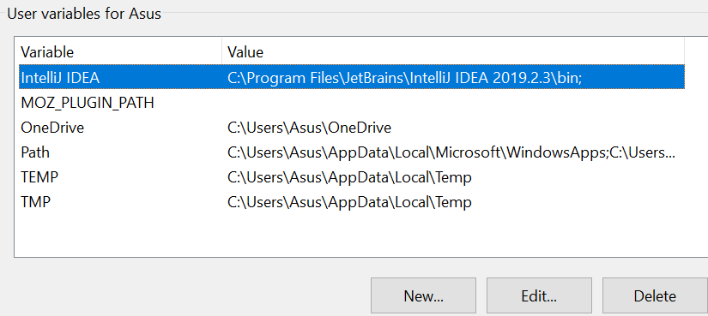
Install ANTLR
3.6 Click on “Edit Environment Variables” > “Environment Variables”
3.7 The following widow will pop up on the screen.

Slide 28
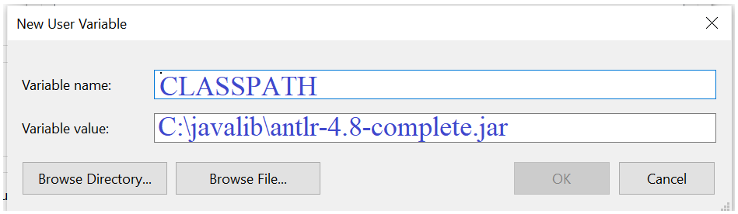
Install ANTLR
3.8 Click on “New”. The following window will be displayed

Slide 29
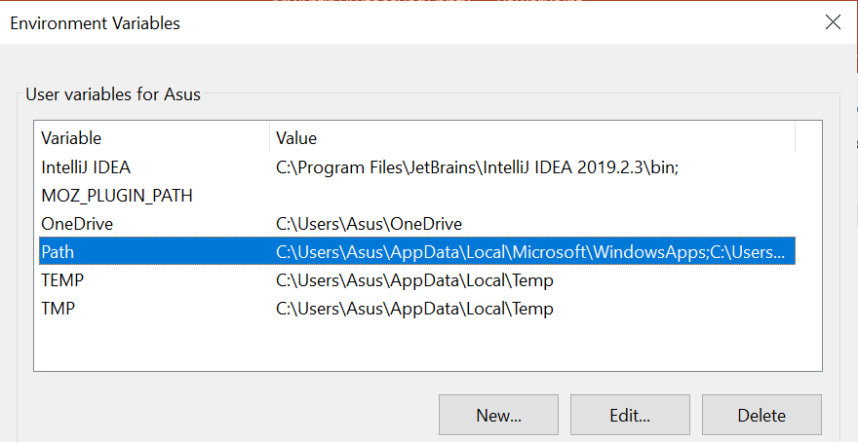
Install ANTLR
3.9 Add Java path to Path by clicking on the “Path” option

Slide 30
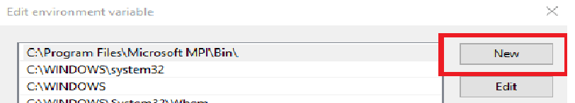
Install ANTLR
3.10 The following window will be opened. Click on the push-button, labeled “New”.

Slide 31
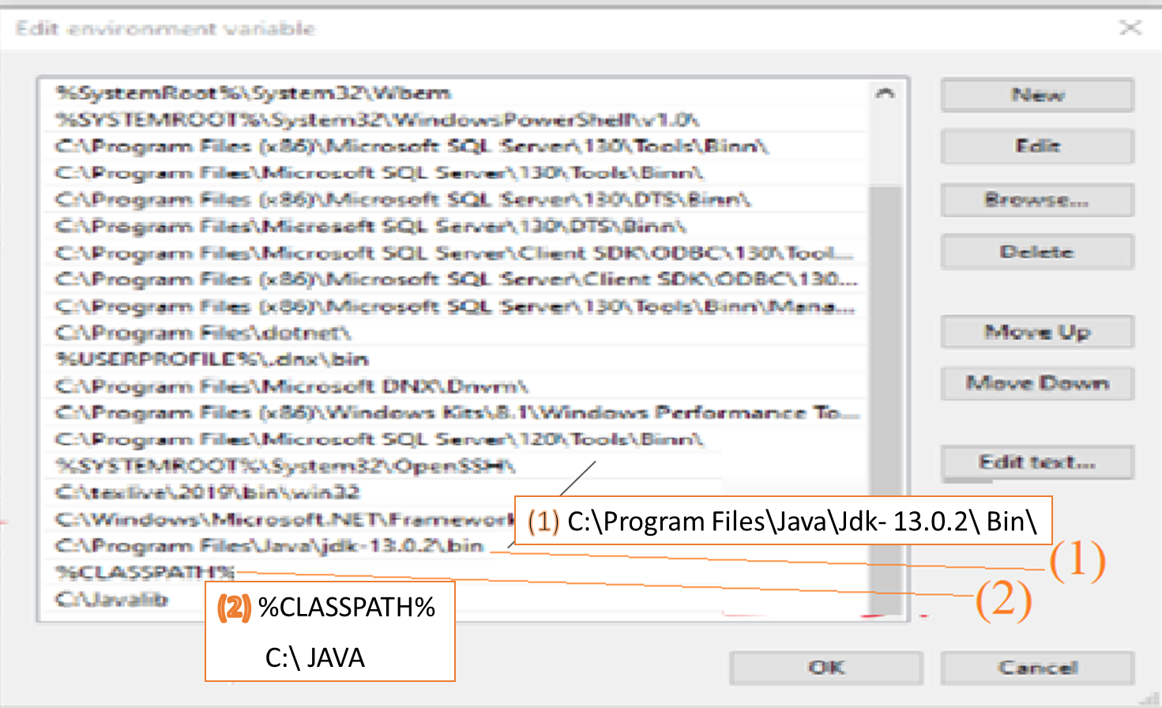
Install ANTLR
3.11 Enter java compiler path and the Class Path entered before.

Slide 32
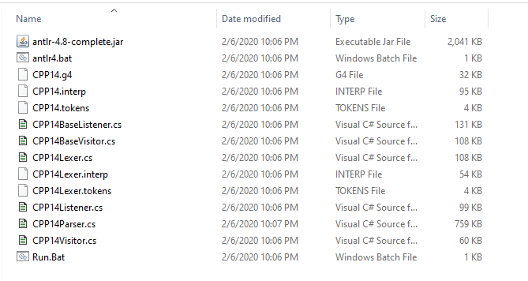
Install ANTLR
3.12.1 Now by doing such settings it will be possible to access the downloaded jar file.
The above image is from the javalib folder, which contains the antlr-4.8-complete.jar software we downloaded from www.antlr.org.

Slide 33
Running ANTLR
Step 2: Add or create a grammar file (*.g4) in your project
2.1 Download the desired Grammar from the following URL and save it in the
C:\javalib directory
https://github.com/antlr/grammars-v4/blob/master/cpp/CPP14.g4
2.2 Run Antlr to create lexer and parser
Create two batch files as follows:
(1) antlr4.bat: java org.antlr.v4.Tool%*
(2) grun.bat: antlr4 -listener -visitor -Dlanguage=CSharp CPP14.g4
Or run the following commands:
java org.antlr.v4.Tool -Werror -o {outputdirectory} -Dlanguage=CSharp input.g4 -visitor
java -jar antlr-4.8-complete.jar -Dlanguage=CSharp input.g4 -visitor

Slide 34
Running ANTLR
In antlr4.bat the command java org.antlr.v4.Tool% is included. This command actually invokes the antlr.v4 software.
The second batch file, grun.bat, includes the command:
antlr4 -listener -visitor -Dlanguage=CSharp CPP14.g4.
In this command:
Using the -listener -visitor switches we have actually requested that this command generate both these files in addition to the parser and lexer.
Dlanguage = CSharp tells antlr to generate the files generated from CPP14.G4 should be in C#.

Slide 35
Running ANTLR
After executing this batch file, all the required files will be generated and saved in the JAVALIB folder.

Slide 36
Running ANTLR
Alternatively:
2.2 Run Antlr to create listener and visitor
java org.antlr.v4.Tool -Werror -o {outputdirectory} -Dlanguage=CSharp input.g4 -visitor
java -jar antlr-4.5.1-complete.jar -Dlanguage=CSharp input.g4 –visitor -listener
2.3 As a result the Parser, Lexer, Visitor and Listener classes will be created

Slide 37
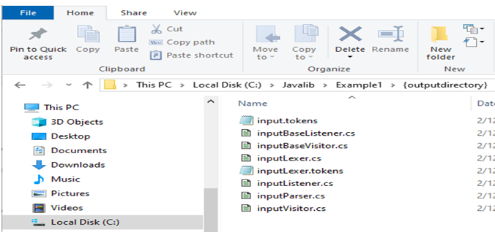
Running ANTLR

Slide 38
Install ANTLR in C#
Adding ANTLR plugin:
A JRE needs to be on the executable search path (i.e. the absolute path is in the %PATH% environment variable)
Installation of the ANTLR4 packages is via the NuGet Package Manager
Grammar file(s)’ compilation options need(s) to be customized manually by editing the project’s configuration file (*.csproj)
The latest stable version of ANTLR4 (version 4.3.0) is only supported on .NET Framework 4.5 and below, therefore there is a need to change the target framework from the default (if the default version is higher)
References to the ANTLR namespaces are required

Slide 39
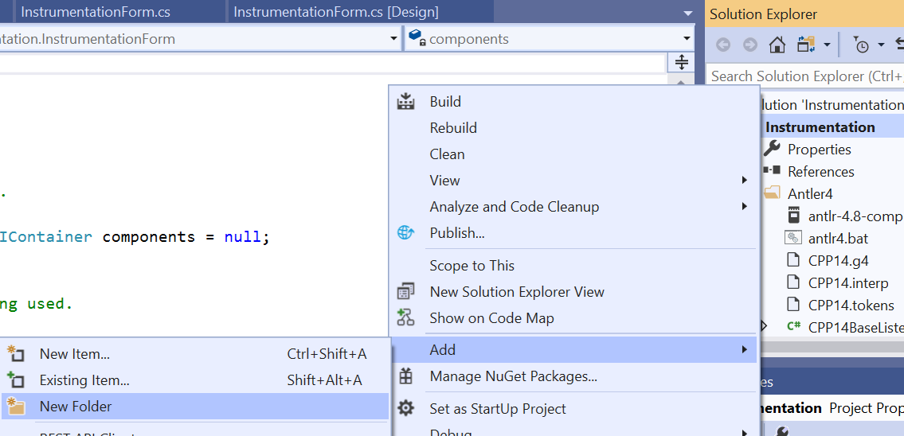
Install ANTLR in C#
First, create a Windows Form App project in Visual Studio.
Right click on the project name in the solution explorer and add a folder, Antlor4.

Slide 40
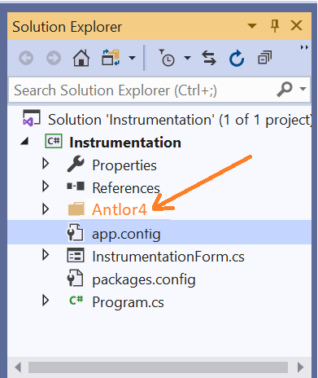
Install ANTLR in C#
Copy the content of javalib into the Antlor4 folder.

Slide 41
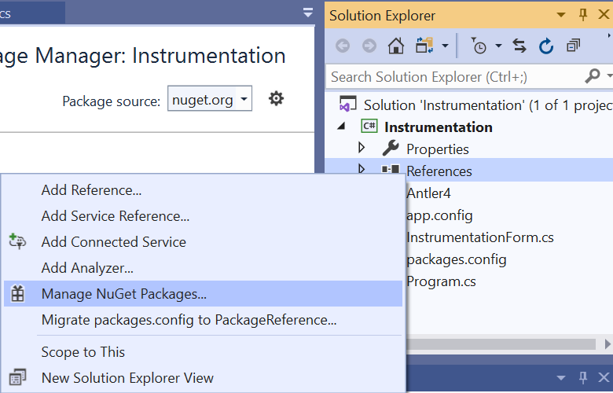
Install ANTLR in C#
Now after adding the folder to the visual environment we need to add a package to use Antlr in the .net environment.
To do so, right-click on References and then in the popup window click on the Manage NuGet package option and then add a package called antlr4.rantime.standard to the project.

Slide 42
Install ANTLR in C#
NuGet:
NuGet is a package and dependency manager.
Helps to find, install, update and remove packages.
Focuses primarily on package and dependency management.
Lists all available packages for download.
Adding a NuGet package to a Visual Studio project is similar to adding a reference.
Go to Solution Explorer,
Right-click on the References folder,
Click Manage NuGet Packages.

Slide 43
Install ANTLR in C#
For Visual Studio 2017:
Right click the top-level solution node in the Solution Explorer window and select Manage NuGet Packages for Solution.
In the upper left, choose Browse and then choose nuget.org as the Package source
Next to the Search box, check Include prerelease
In the Search box, type Antlr4 to search for the package
In the search results, locate and select the package called Antlr4. Verify that the name is listed as Antlr4.
In the right pane, select the C# projects you want to use ANTLR4 by clicking their checkboxes
Click Install under the list of projects
Approve changes and accept license agreements, if prompted.

Slide 44
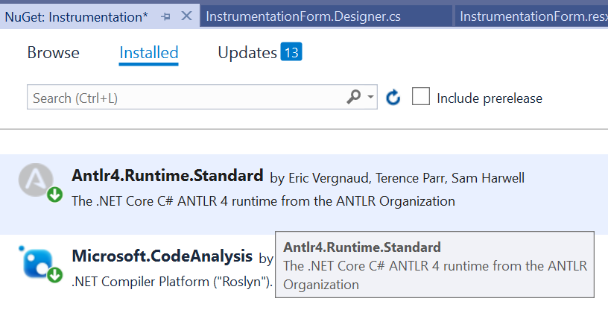
Install ANTLR in C#

Slide 45
Install ANTLR in C#
After adding the packages to our project, we use their namespaces and use the capabilities of these packages in our project.
using System;
using System.Collections.Generic;
using System.ComponentModel;
using System.Data;
using System.Drawing;
using System.Globalization;
using System.Linq;
using System.Reflection;
using System.Resources;
using System.Text;
using System.Windows.Forms;
using Antlr4.Runtime;
using Antlr4.Runtime.Misc;
using Antlr4.Runtime.Tree;
using static CPP14Parser;

Slide 46

Assignment 1
Subject : Install & use ANTLR
Deadline: Two weeks
Mark: 5 out of 100.

Slide 47

Assignment 1
Write a program to accept a C++ program as input and generate parse tree for the program
Run ANTLR to generate a lexical analyzer (lexer) and a parser for C++ .
Give a C++ program to your C++ compiler to generate parse and depict the parse tree for the program.
Provide a report describing the installation step and your program.
You may generate lexer and parser for other languages such as C# , Java, and Python.
Your code could be either in Python, or C# language.

Slide 48
Assignment 1
Steps to install ANTLR:
Download Java JDK 13.0.2 (64-bit). Java Development Kit (64-bit).
Date released 2018. Free Download. (159.8 MB).
https://www.filehorse.com/download-java-development-kit-64/old-versions/page-2/
Download Antlr 4.8-complete.jar (or whatever version) from https:
https://www.antlr.org/download/
Create a directory for 3rd party Java libraries :
C:\Javalib
Save antlr-4.8-complete.jar to C:\Javalib.

Slide 49
Assignment 1
Steps to install ANTLR:
Add the followings to ’environment variables’ in windows 10.
C:\Program Files\Java\jdk-13.0.2\bin
C:\Javalib
%CLASSPATH%
Add C:\Javalib\antlr-4.8-complete.jar as the variable value of the environment variable named CLASSPATH.
Download the CPP grammar from the following URL address into “C:\javalib” folder:
https://github.com/antlr/grammars-v4/tree/master/cpp
Similarly the Python grammar could be downloaded from:
https://github.com/antlr/grammars-v4/tree/master/python

Slide 50
Assignment 1
Steps to install ANTLR:
Generate parser and lexer
java -jar antlr4-4.8.jar -Dlanguage=CSharp CPP14.g4
or
java -jar antlr4-4.8.jar -Dlanguage=Phyton3 CPP14.g4
or
java -jar antlr4-4.8.jar -Dlanguage=Cpp grammar.g4
For instance suppose you choose to generate Python3 code:
java -jar ./antlr-4.8-complete.jar -Dlanguage=Python3 CPP14.g4

Slide 51
Assignment 1
Steps to install ANTLR:
This will generate the following files, which you can then integrate in your project
CPP14Lexer.py: including the source of a class, CPP14Lexer.
CPP14Parser.py: including the source of a class, CPP14Parser.
CPP14Listener.py: including the source of a class, CPP14Listener.
In addition to the above three files, four other files are generated that are used by ANTLR. All these files should be copied into the folder where you save your Python program.

Slide 52
Assignment 1
Steps to install ANTLR:
To access the ANLR-4 runtime library within a Python project, MyProject, in the PyChram environment select:
File > Setting > MyProject > Project interpreter > + (add)
Search for “ANTR4” in the popped up window, select “ANTLR4 runtime Python3” option, and click on the “install package” button.
http://ati.ttu.ee/~kjans/antlr/pycharm_antlr4_guide.pdf

Slide 53
Assignment 1
Steps to install ANTLR:
Write a program to generate and display Parse tree for a given C++ program.
https://www.thetopsites.net/article/50064110.shtml
https://github.com/antlr/antlr4/blob/master/runtime/Python3/src/antlr4/Parser.py

Slide 54
Assignment 1
Note: CLASSPATH is a parameter in the Java Virtual Machine or the Java compiler that specifies the location of user-defined classes and packages. The parameter may be set either on the command-line, or through an environment variable.
To add ANTLR to class path,
Click on ‘Windows search’ key and enter “environment”
go to the following address (you may click on the following address to get access to the related document):
Control Panel > System > Advanced system settings > Environment variables
Under Environment Variables, you can see two sections.
The top section shows User variables,
The bottom section shows System Variables.

Slide 55
Assignment 1
In either of them, find for Variable name PATH or path.
If it is available click on path in the system variable window and then press edit.
Pressing the “Edit” button a new window labeled ‘Edit system variable’ will pop up.
Press the “new” button, and add the following three items to the list”
The path for accessing Java: C:\Program Files\Java\jdk-13.0.2\bin
The 3rd party Java libraries address: C:\javalib
Class path: %CLASSPATH%

Slide 56
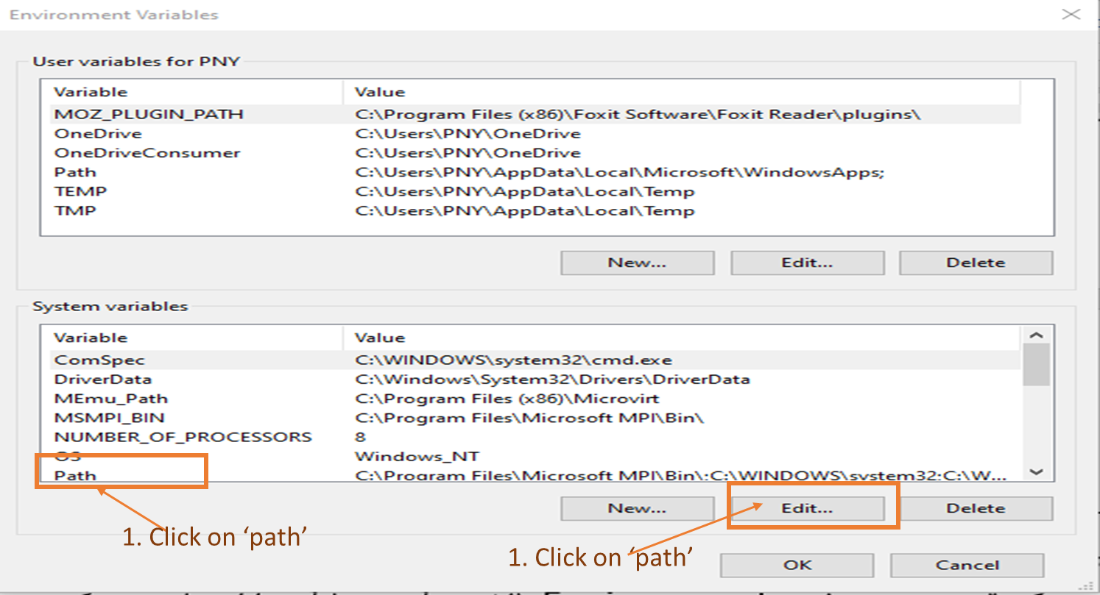
Assignment 1

Slide 57
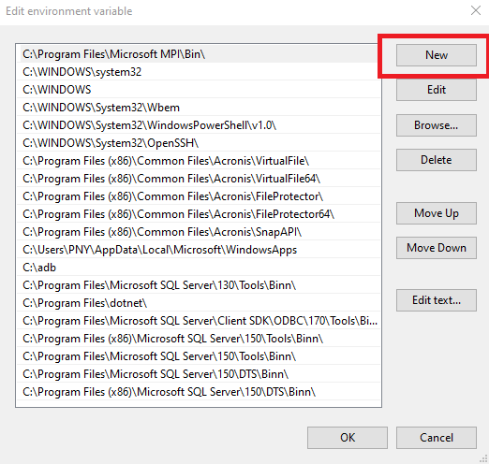
Assignment 1

Slide 58
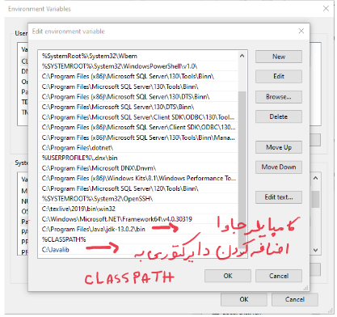
Assignment 1

Slide 59
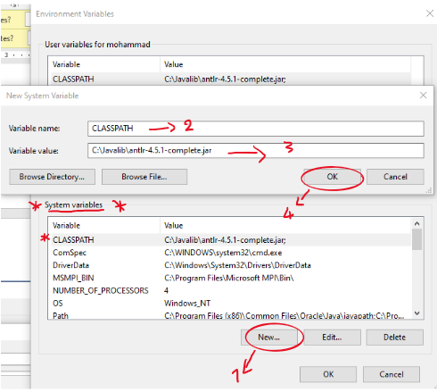
Assignment 1

Slide 60


